Slide 1



GROUP 6

Slide 2

Introduction
Website “Botanical.corp” is a planting website that provides a variety of information about Hydroponics, How To Plant, and Variety of Plants that can be planted with hydroponics system. And in our website have five main menu there are Home, About us, Shop, Gallery, and Contact us menus. And the advantages of our website is, the user can learn about hydroponics planting, variety of plants that can be planted with hydroponics system, and can order seeds in the same website

Slide 3

Introduction
The website Botanical.corp made for easier the customers to see about hydroponics system, how to plant and buying seeds from the same page. Customers can see every each product and also the description. If the customers felt not good about the Botanical.corp by the product or want to give some critics and suggestion, customer can express it in kritik and saran columns. And the advantages of our website is, the user can learn about hydroponics planting, variety of plants that can be planted with hydroponics system, and can order seeds in the same website
Website “Botanical.corp” is a planting website that provides a variety of information about Hydroponics, How To Plant, and Variety of Plants that can be planted with hydroponics system. And in our website have five main menu there are Beranda, Galeri, Cara Penanaman, Produk, and About us menus. And the advantages of our website is, the user can learn about hydroponics planting, variety of plants that can be planted with hydroponics system, and can order seeds in the same website

Slide 4

System Summary

Slide 5
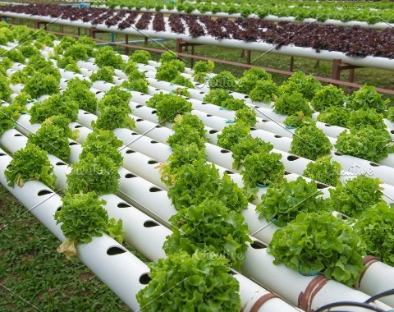
Activities List
Website “Botanical.corp” is a planting website that provides a variety of information about Hydroponics, How To Plant, and Variety of Plants that can be planted with hydroponics system. And in our website have five main menu there are:
Home as a main of our website, in the home menu we explain basic information about hydroponics system, advantages planting with hydroponics system, and why customer should buy seeds in our website and how to start planting.
About us menu is menu that contain our corporate information.
Shop , in shop menu we have 2 submenus:
Shop, the menu that contain variety of plants that can planted with hydroponics systems and price.
Checkout, menu for ordering seeds
Galeri menu is a collection photos of our corporate plantation.
Contact us , is the menu for customer to give us critics and suggestion.

Slide 6
HTML PAGES
C:\Users\LENOVO\Documents\NetBeansProjects\project fix2x\Botanical\web\index.html

Slide 7
Thank you

